Slide 1
Unit 7: Intro to Optimization!
Break Out Problem!

Slide 2
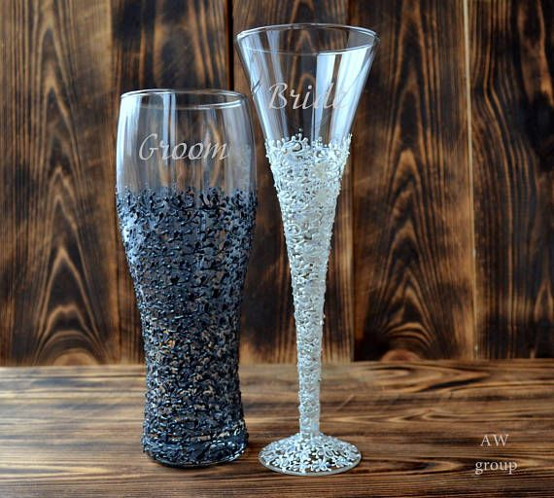
The Problem
A local family-owned plastic cup manufacturer wants to optimize their production mix in order to maximize their profit. They produce personalized beer mugs and champagne glasses. The profit on a case of beer mugs is $25 while the profit on a case of champagne glasses is $20.
The cups are manufactured with a machine called a plastic extruder which feeds on plastic resins. Each case of beer mugs requires 20 lbs. of plastic resins to produce while champagne glasses require 12 lbs. per case. The daily supply of plastic resins is limited to at most 1800 pounds. About 15 cases of either product can be produced per hour. At the moment the family wants to limit their work day to 8 hours.
Sub problems:
Identify the Objective Function
Identify the Constraints (Explicit and Implicit).
Use Excel Solver to find the optimal number of each to maximize the profit.

Slide 3
Objectives and Constraints
Objective Function: Profit = 25B + 20C
Constraints:
20B + 12C <= 1800
B + C = 120
B >= 0
C >= 0

Slide 4
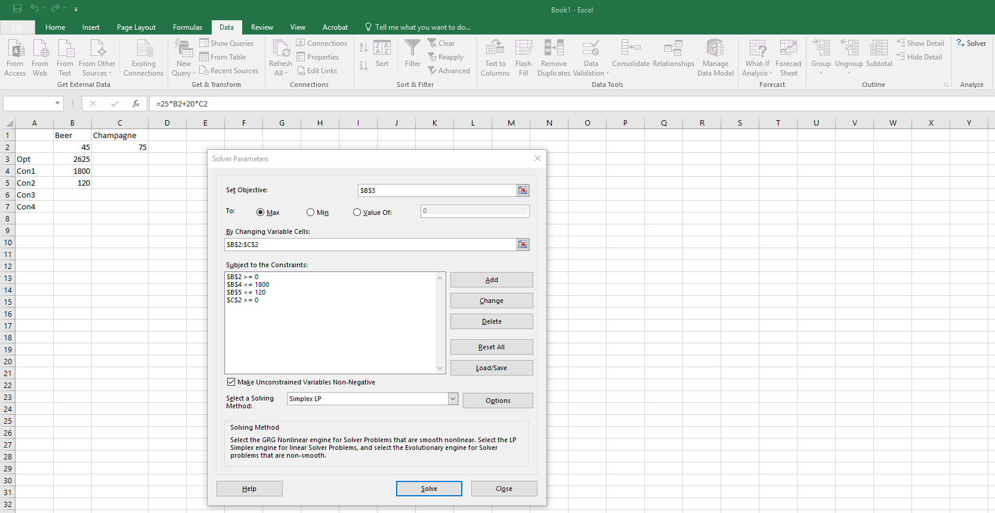
Excel Solver!

Slide 5
Sensitivity Analysis
Let’s say that the family would like to know what the expected increase in profit would be for each additional pound of plastic that available. Perform this calculation for them.
Do this while allowing for fractional mugs and glasses. (Compare to shadow price.)
Do this while restricting your analysis to only whole numbers of mugs and glasses. You may have to be creative here, or simply give an approximate answer. There could be many acceptable answers.
Now let’s say that the family was considering working one additional hour per day. What would be their expected increase in profit (again relaxing the integer constraint on mugs and glasses.)
Now, more practically, the family would like a practical estimate of the increase in profit for working an additional day. Provide them an estimate based on the fact that they can only make whole numbers of mugs and glasses.
Note that these were engraved plastic beer mugs and champagne glasses. The only reason the company needed 20 units of plastic for beer mugs and 12 units of plastic for champagne glasses is to have something thick enough to engrave on. The family has found a different method of engraving that would allow them to engrave on a beer mug made from 18 units of plastic and a champagne glass made from 11 units of plastic. How will this new engraving method effect their profit?
Assume the new method will cost them a one time fee of $10,000 for the machinery and education. How long will it take them to recoup this cost (assuming they are only working the 8 hour day)?

Slide 6
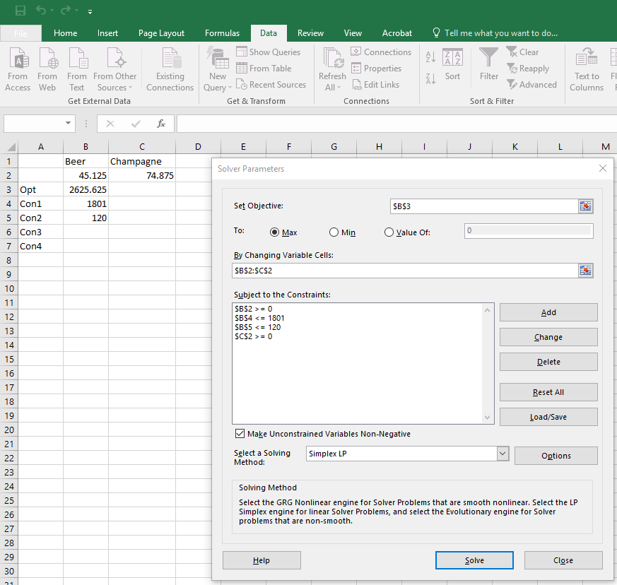
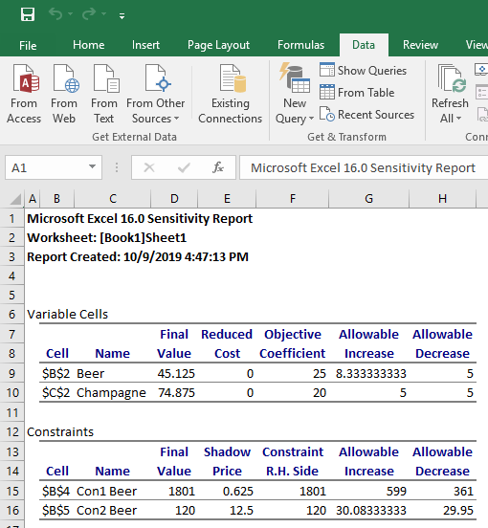
Sensitivity Analysis
Let’s say that the family would like to know what the expected increase in profit would be for each additional pound of plastic that available. Perform this calculation for them.
Do this once while allowing for fractional mugs and glasses. (Compare to shadow price.)
(Profit at 1801) – (Profit at 1800) =
$2625.675 - $2625 = $0.675

Slide 7
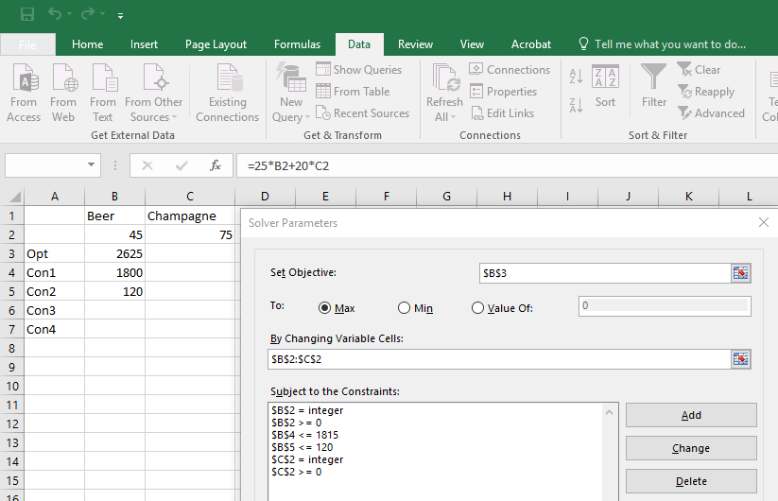
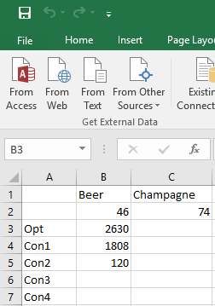
Sensitivity Analysis
Let’s say that the family would like to know what the expected increase in profit would be for each additional pound of plastic that available. Perform this calculation for them.
2. Do this while restricting your analysis to only whole numbers of mugs and glasses. You may have to be creative here, or simply give an approximate answer. There could be many acceptable answers.
(Profit at 1808) – (Profit at 1800) =
$2630 - $2625 = $5

Slide 8
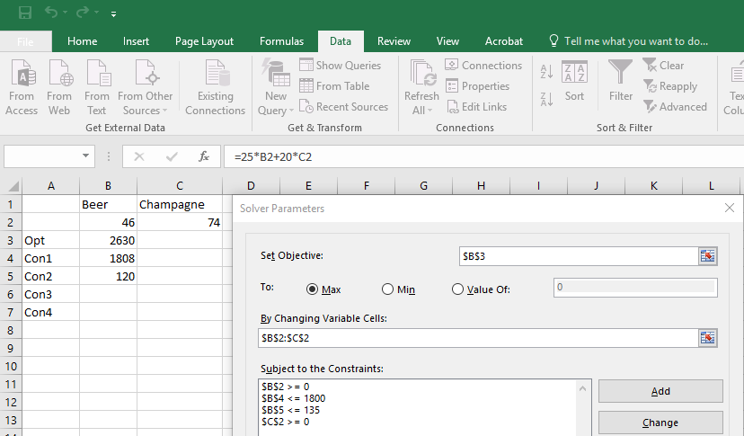
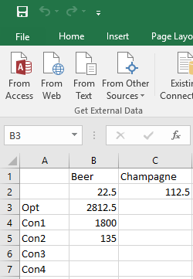
Sensitivity Analysis
Now let’s say that the family was considering working one additional hour per day. What would be their expected increase in profit (again relaxing the integer constraint on mugs and glasses.)
(Profit at 135) – (Profit at 120) =
$2812.50 - $2625.00 = $187.50

Slide 9
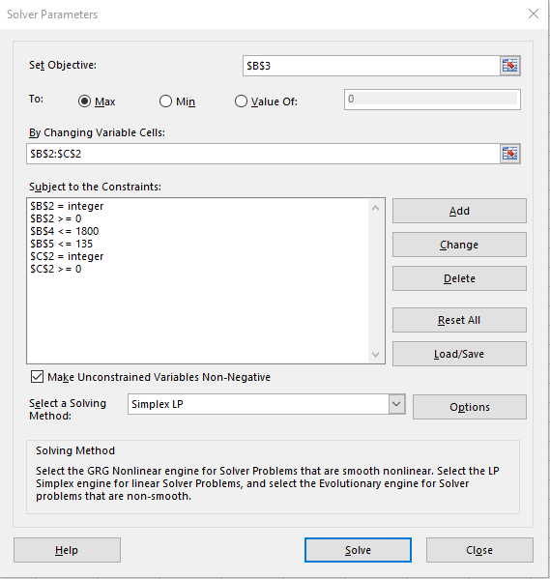
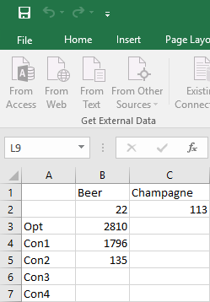
Sensitivity Analysis
Now, more practically, the family would like a practical estimate of the increase in profit for working an additional day. Provide them an estimate based on the fact that they can only make whole numbers of mugs and glasses.
(Profit at 135) – (Profit at 120) =
$2810 - $2625.00 = $185.00
Look at the difference in mugs and glass production!

Slide 10
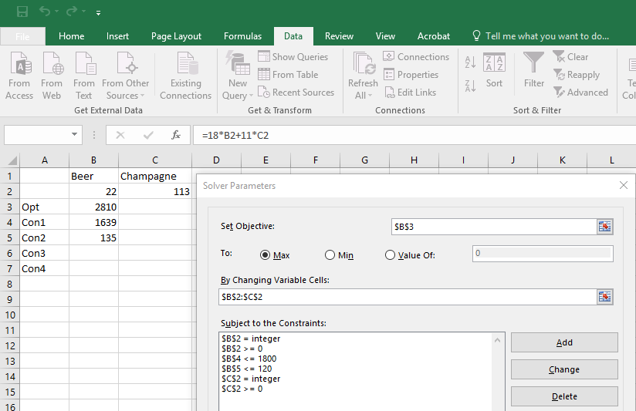
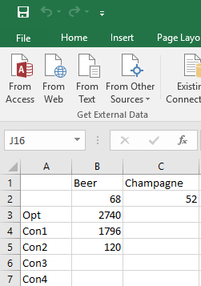
Sensitivity Analysis
Note that these were engraved plastic beer mugs and champagne glasses. The only reason the company needed 20 units of plastic for beer mugs and 12 units of plastic for champagne glasses is to have something thick enough to engrave on. The family has found a different method of engraving that would allow them to engrave on a beer mug made from 18 units of plastic and a champagne glass made from 11 units of plastic. How will this new engraving method effect their profit? (Assume they are back to working 8 hours a day and using a max of 1800 units of plastic.)
(Profit New Method) – (Profit Old Method) =
$2740.00 - $2625.00 = $115.00

Slide 11
Sensitivity Analysis
Assume the new method will cost them a one time fee of $10,000 for the machinery and education. How long will it take them to recoup this cost (assuming they are only working the 8 hour day)?
$10,000/$2740 = 3.65 days = 3.65 * 8 hours = roughly 30 hours.

